Slide 1
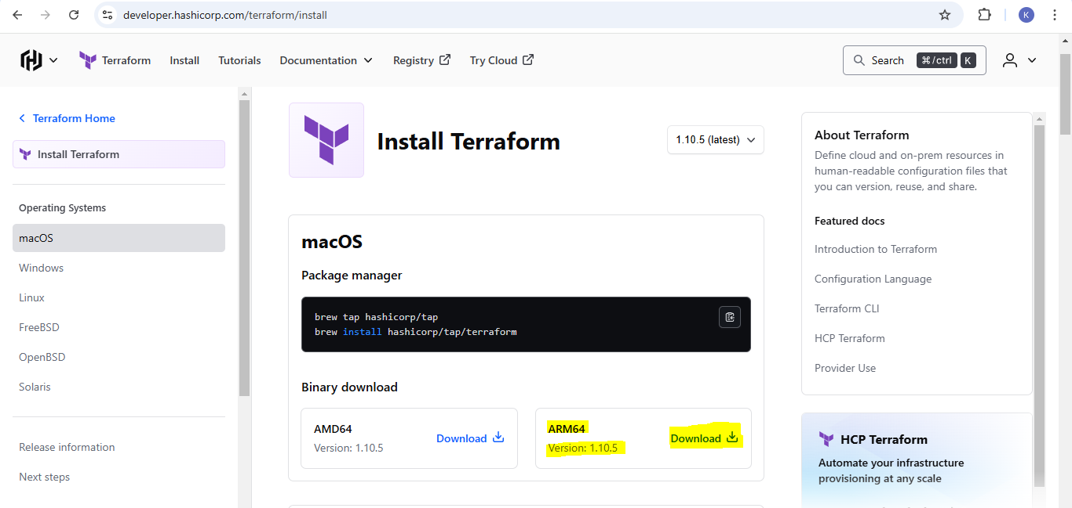
DOWNLOAD TERRAFORM https://developer.hashicorp.com/terraform/install
DEVOPS INSIDER

Slide 2
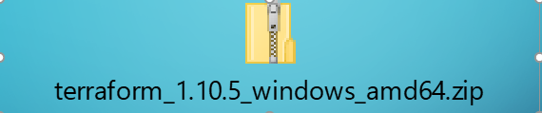
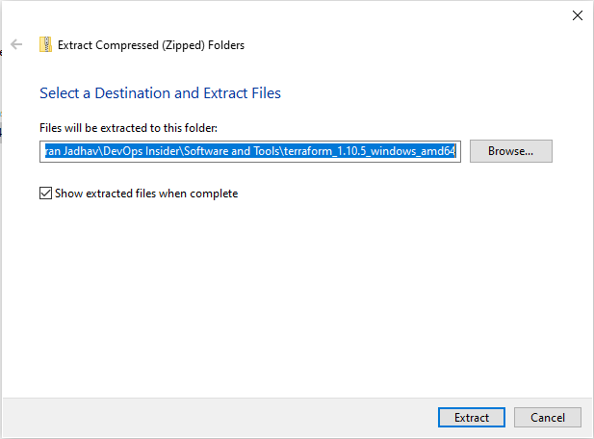
Unzip the downloaded file to extract ON COMPUTER
DEVOPS INSIDER

Slide 3
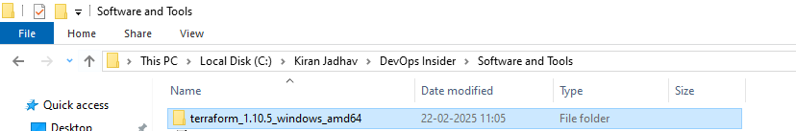
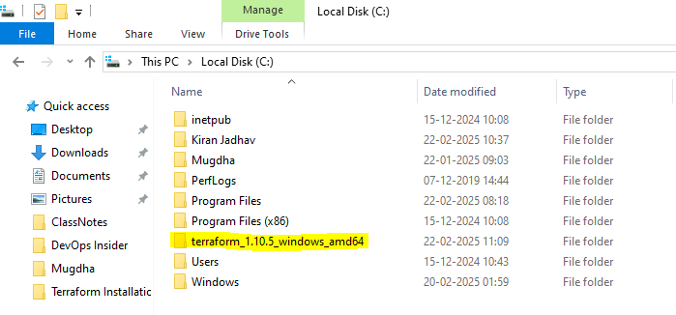
COPY FOLDER AND MOVE TO C:\ Drive OR ANY
DEVOPS INSIDER

Slide 4
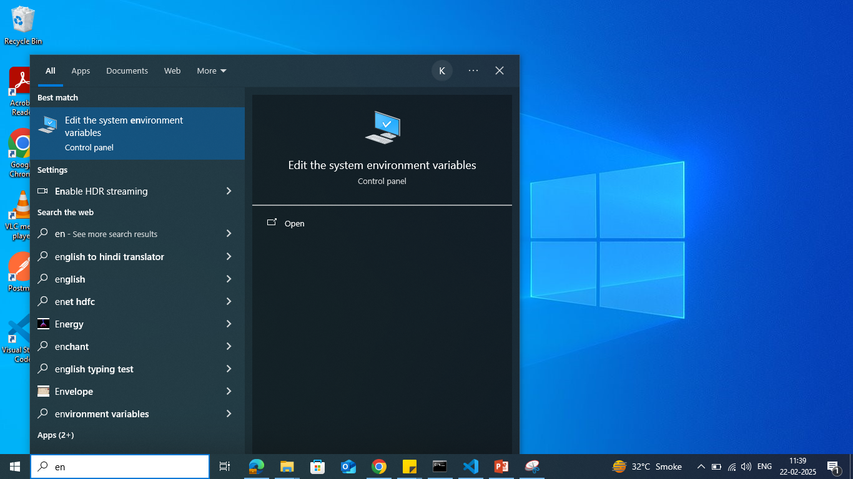
System Properties window, click on Environment Variables
DEVOPS INSIDER

Slide 5
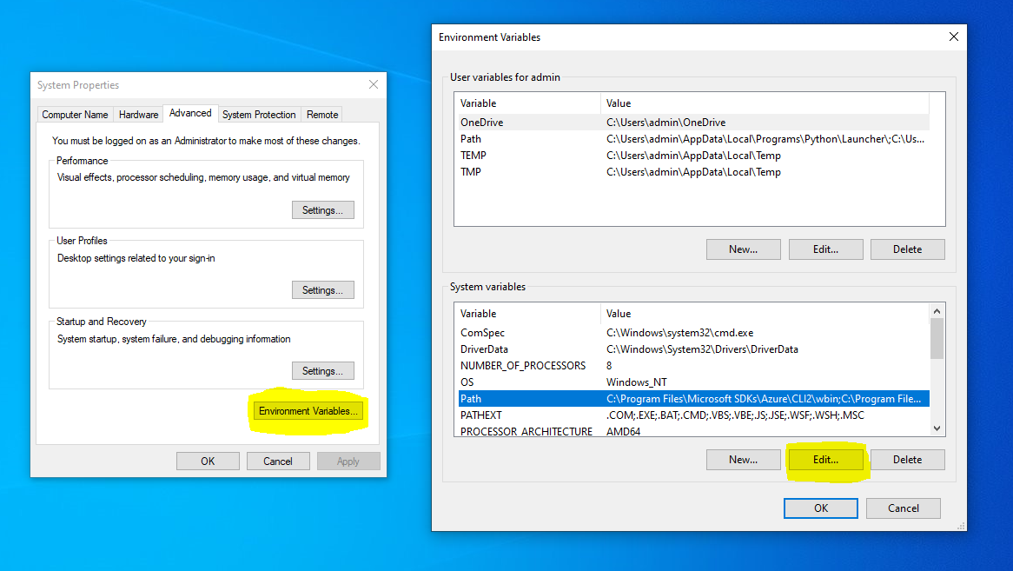
Under SYSTEM VARIABLES variables, select Path and click Edit
DEVOPS INSIDER

Slide 6
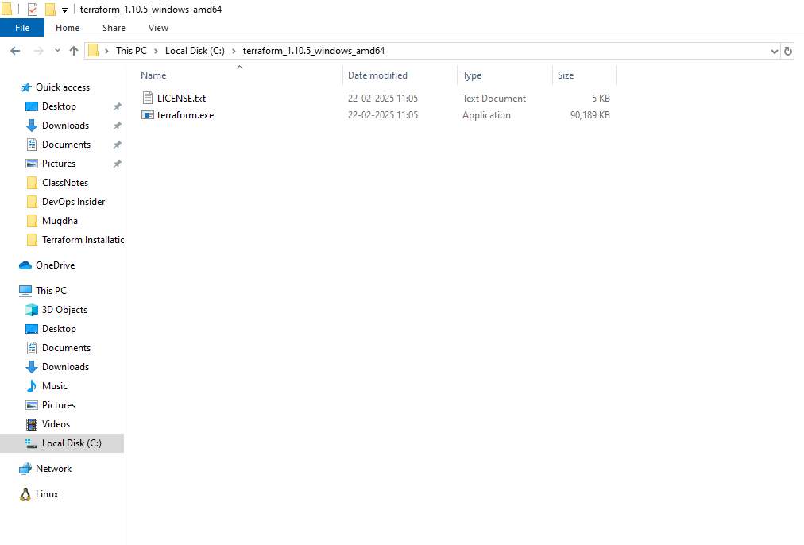
COPY PATH directory containing C:\terraform_1.10.5_windows_amd64
DEVOPS INSIDER

Slide 7
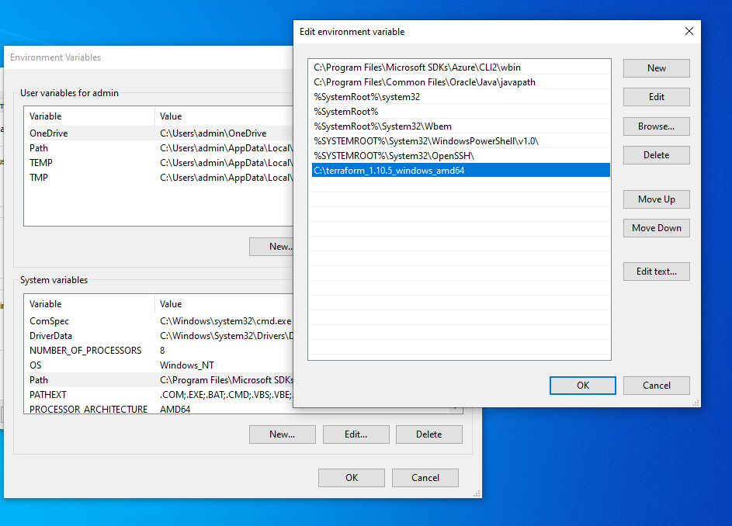
ADD Path in Edit Environment variables BY SELECT NEW AND OK
DEVOPS INSIDER

Slide 8
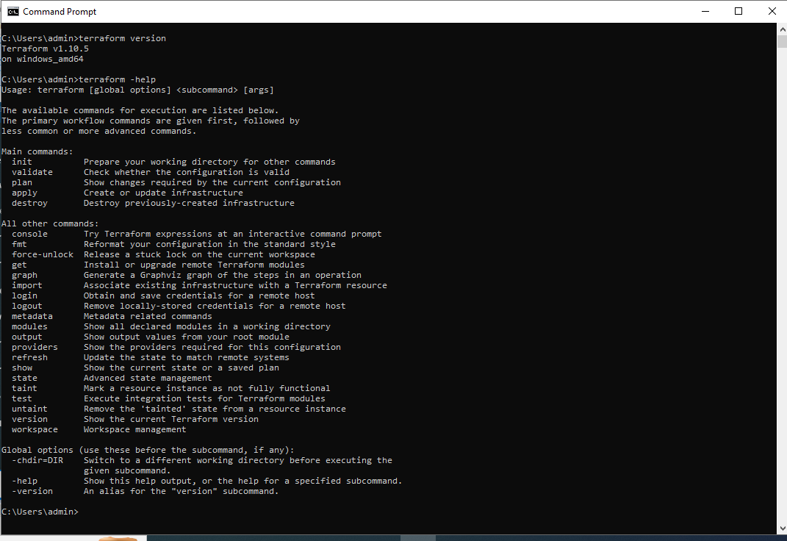
Open a new Command Prompt and run
DEVOPS INSIDER

Slide 9
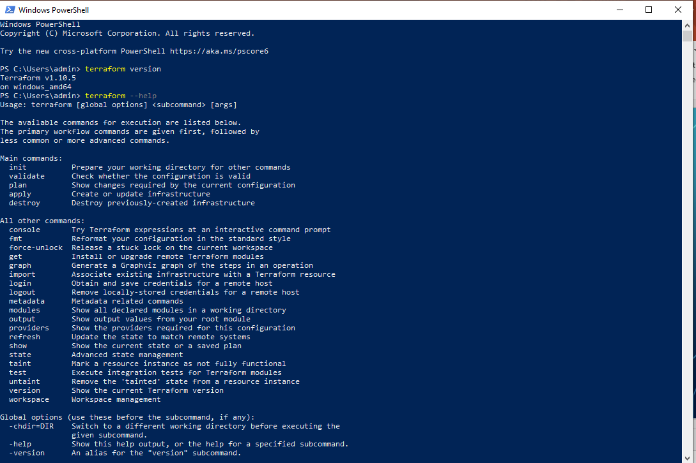
Open a new Command Prompt and run
DEVOPS INSIDER

